Slide 1

The Art of Game Design
Based on Jesse Schells book
The Art of Game Design

Slide 2
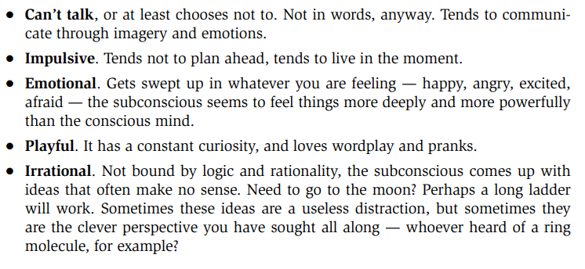
Creative Subconscious

Slide 3
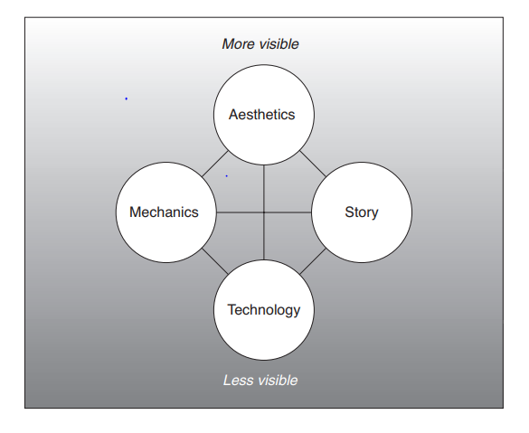
The Four Basic Elements

Slide 4
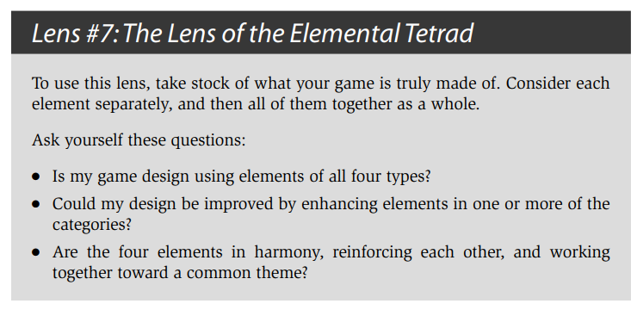
The Lens of the Elemental Tetrad

Slide 5
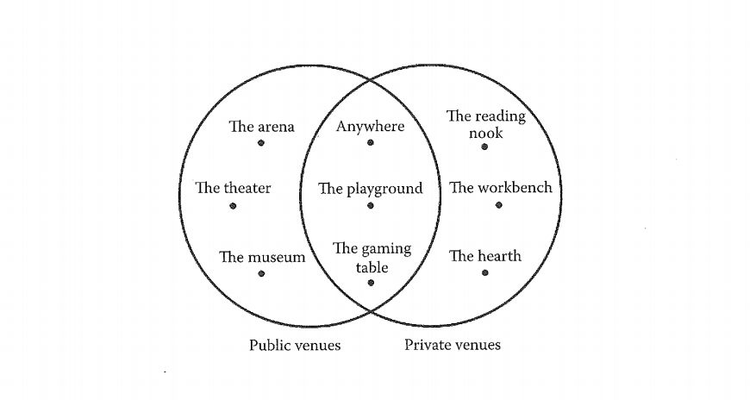
The Shifting Sands of Platform

Slide 6
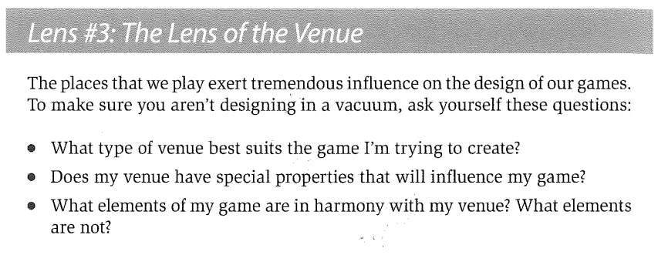
The Lens of The Venue

Slide 7
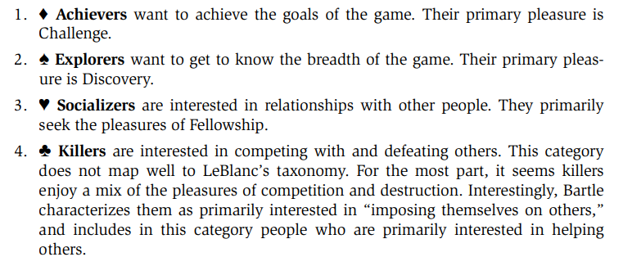
Bartle’s Taxonomy of Player Types

Slide 8
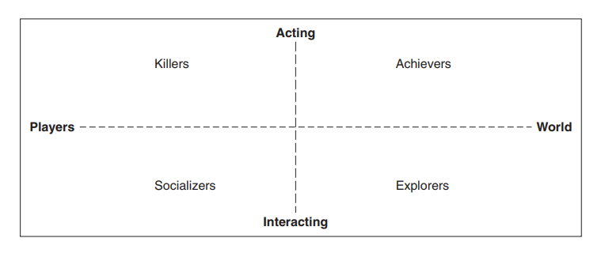
Bartle’s Taxonomy of Player Types

Slide 9
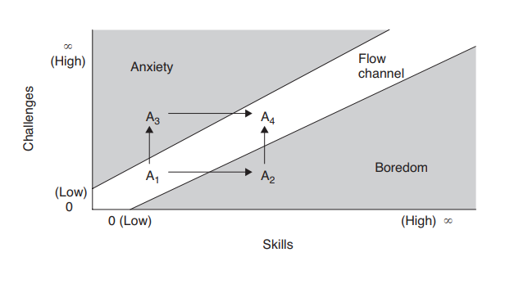
Staying in the Flow

Slide 10
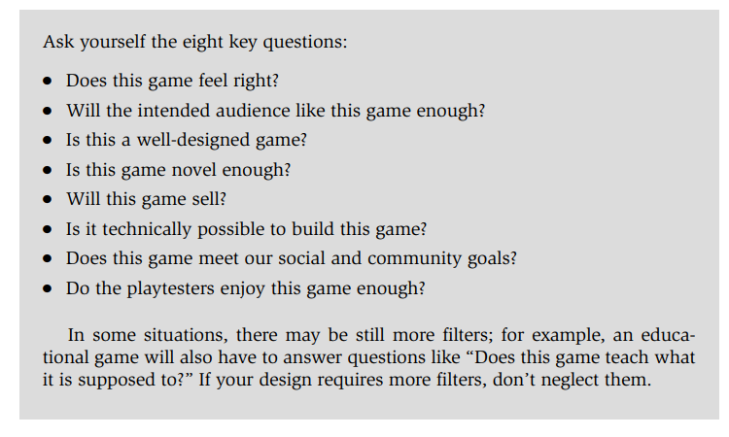
The Lens of the Eigth Filters

Slide 11
Dagens opgave
Tag udgangs punkt i ovenstående slides når i brain stormer om ideer til jeres spil.

